Slide 1
Advancing the Science of Transportation Demand Modeling
TRB 97th Annual Meeting
Washington, DC
January 9, 2017
Topic 3: Advancing Knowledge
in a Generalizable and Testable Manner
Greg Erhardt, University of Kentucky David Ory, Sidewalk Labs Kay Axhausen, ETHZ - Swiss Federal Institute of Technology Giovanni Circella, Georgia Institute of Technology (Georgia Tech) Song Gao, University of Massachusetts, Amherst Stephane Hess, University of Leeds Josephine Kressner, Transport Foundry Hani Mahmassani, Northwestern University Eric Miller, University of Toronto Rolf Moeckel, Technical University of Munich Alexei Pozdnoukhov, University of California, Berkeley Paul Waddell, University of California, Berkeley
Topic 3: Advancing Knowledge
in a Generalizable and Testable Manner

Slide 2
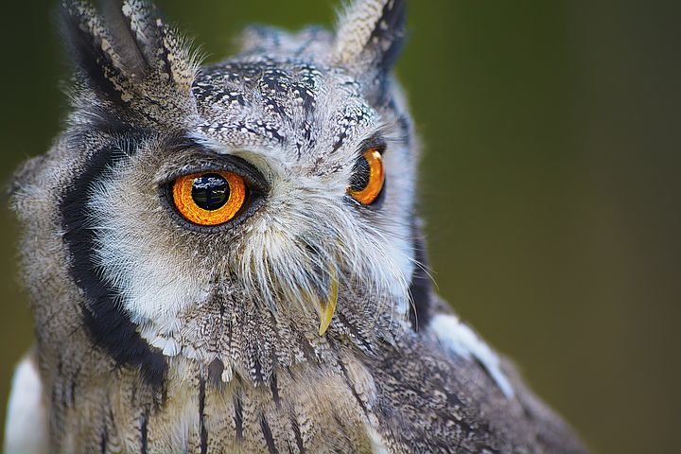

What makes something scientific?
Words of wisdom?
“You’re not wrong if no one can contradict you.”
Popper (1935) argues for falsifiability as the demarcation of science.
This can be through experiment, or through logic.
Pixabay.com
“By the time it gets built, I’ll be retired…or dead.”
Popper, Karl. Logic of Scientific Discovery. London: Routledge, reprinted 2005.
commons.wikimedia.org
Notes:
Note that science is diverse, and this is a hard question!

Slide 3
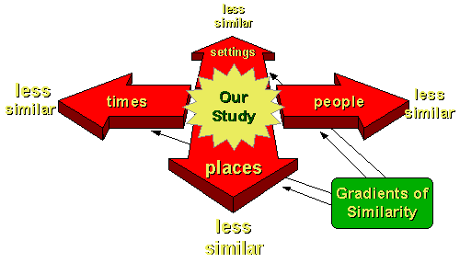
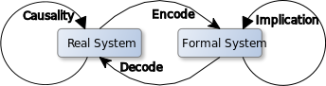
What makes something generalizable?
External validity is the degree to which the conclusions in your study would hold for other persons in other places and at other times.
Campbell, Donald T., and Julian C. Stanley. “Experimental and Quasi-Experimental Designs for Research.” Handbook of Research on Teaching (NL Gage, Ed.), 1966, 171–246.
Cook, Thomas D. Quasi-Experimentation: Design & Analysis Issues for Field Settings. First Edition. Boston: Houghton Mifflin, 1979.
https://www.socialresearchmethods.net/kb/external.php
https://en.wikipedia.org/wiki/Scientific_modelling#cite_note-10

Slide 4
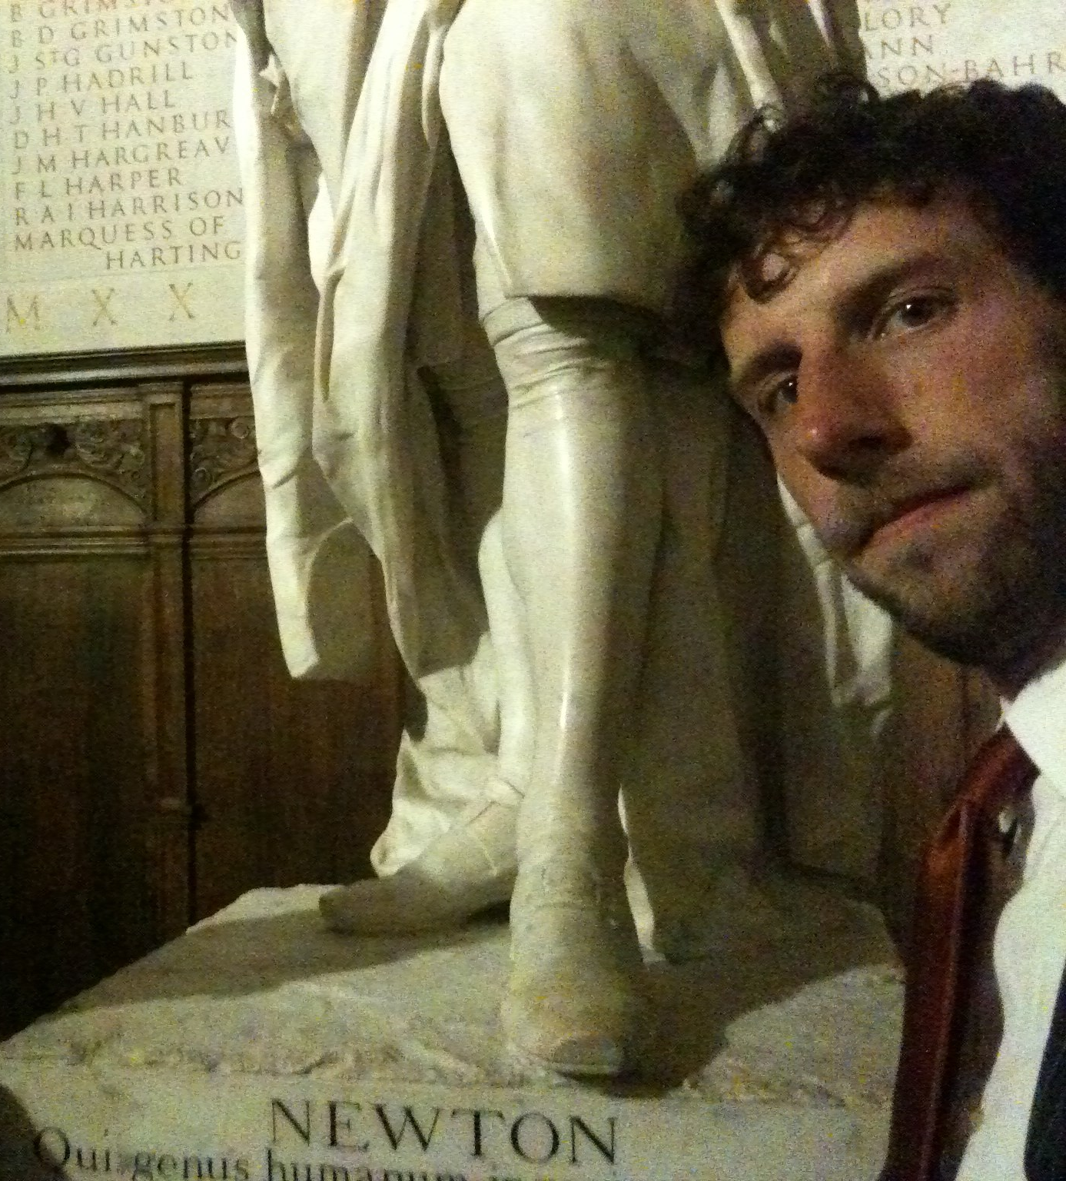
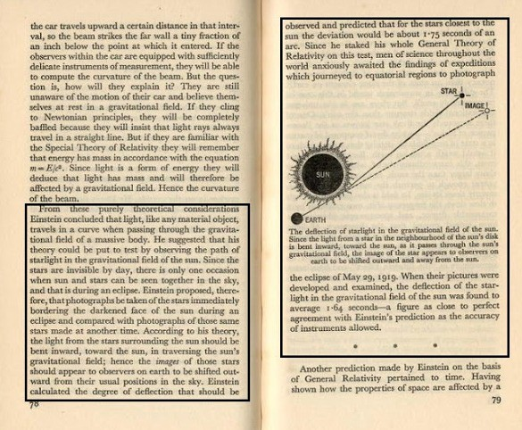
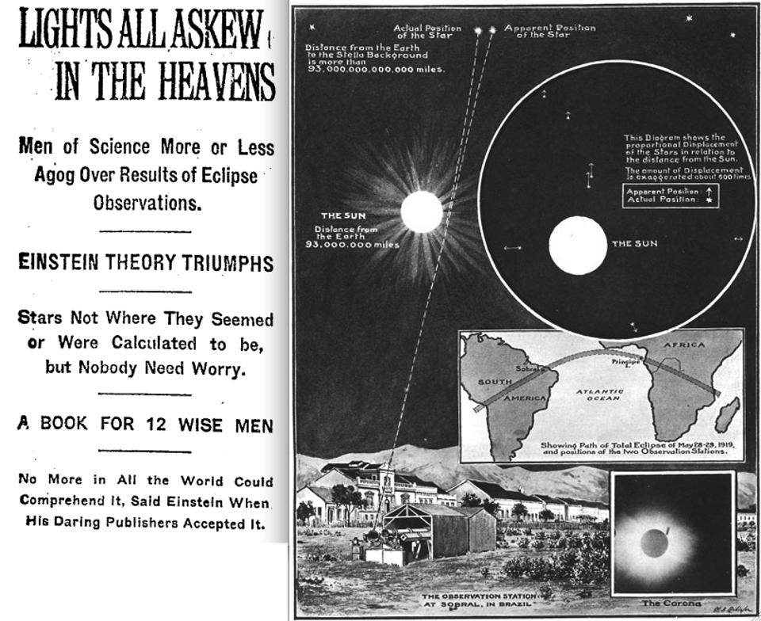
“Science was a series of models continuing to replace each other.”
Tolk, Andreas. “Learning Something Right from Models That Are Wrong: Epistemology of Simulation.” In Concepts and Methodologies for Modeling and Simulation, 87–106. Simulation Foundations, Methods and Applications. Springer, Cham, 2015.
Einstein’s model:
Was more general than Newton’s
Made testable predictions
But Newton’s model remains useful!

Slide 5
The role of modeling in science
“I have been, and remain, entirely committed to the idea that modeling is the essence of science and the habitat of all epistemology.
R. Rosen, Essays on Life Itself, 1500 edition. New York: Columbia University Press, 1999.
Simulation is a “third way of doing science” that allows us to conduct virtual experiments and gain insights that otherwise would not be possible.
Axelrod, Robert. “Advancing the Art of Simulation in the Social Sciences.” In Handbook of Research on Nature-Inspired Computing for Economics and Management, edited by Jean-Philippe Rennard, 90–100. Hersey, PA: Idea Group, 2006.

Slide 6
How do travel models do?
Scientific Method
Travel Forecasting Practice
Collect and analyze travel data for my city.
Develop model based on a hypothesis of travel behavior.
Make predictions with a 20-year horizon.
Wait.
Observation and description of natural phenomenon.
Formulation of a hypothesis to explain the phenomenon.
Use the hypothesis to predict other phenomenon or results.
Perform an experiment or experiments to ensure that results predicted based on hypothesis are achieved in the experiments.
Adapted from: Sant, Joseph (2017). The Scientific Method, Hypothesis, Prediction and Test. Retrieved from http://www.scientus.org/Science-Method.html on Apr 14, 2017.

Slide 7
Not just us → a challenge for modeling and simulation broadly
“While the complexity of simulations allow for them to extend our cognitive capabilities it also makes it extremely challenging and time consuming to independently verify and validate the simulation and it’s results. Accordingly this independent testing is rarely practiced, but it is absolutely vital in the scientific method because without it the whole philosophy pragmatically falls apart and no significant progress can be made beyond individual self-interests.”
Tolk, Andreas, Brian L. Heath, Martin Ihrig, Jose J. Padilla, Ernest H. Page, E. Dante Suarez, Claudia Szabo, Paul Weirich, and Levent Yilmaz. “Epistemology of Modeling and Simulation.” In Proceedings of the 2013 Winter Simulation Conference: Simulation: Making Decisions in a Complex World, 1152–1166. IEEE Press, 2013.

Slide 8
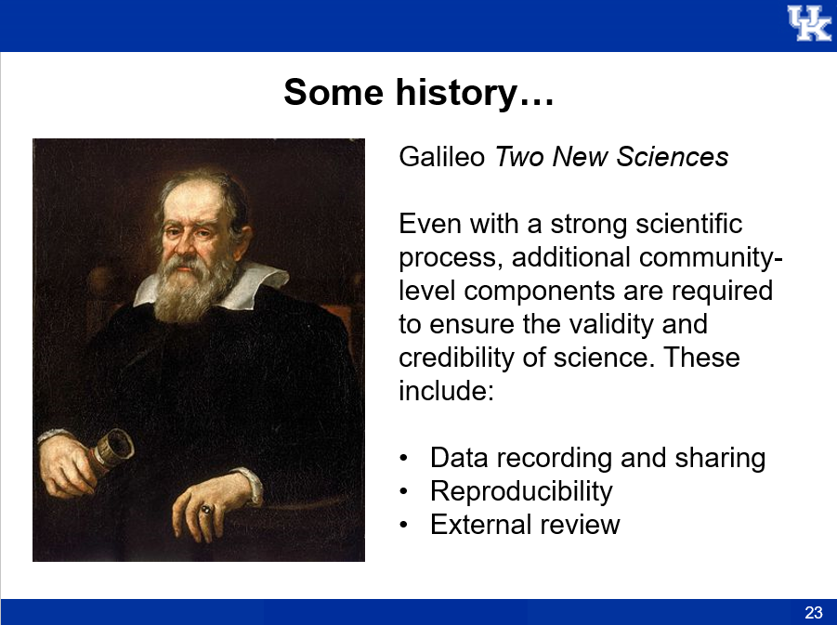
Why code?
Coding is a form of communication.
It records our assumptions and methods in a very precise way. It is the modern day lab notebook.
We should write code for other people!
This promotes a strong scientific process

Slide 9
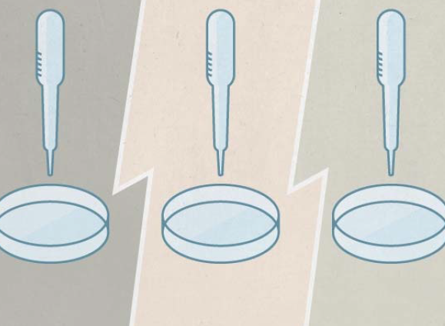
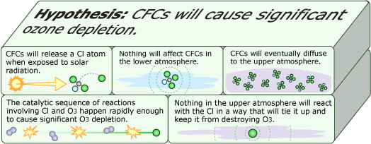
How do other scientific fields handle this?
Life Sciences
Nature reproducibility initiative.
Modeling & Simulation in Social Science
Verification & Validation
Reproducibility & Replication
Atmospheric Modeling
Biomedical Research
Understanding the effect of CFCs on ozone depletion
Rigorous Science: A How-To Guide

Slide 10
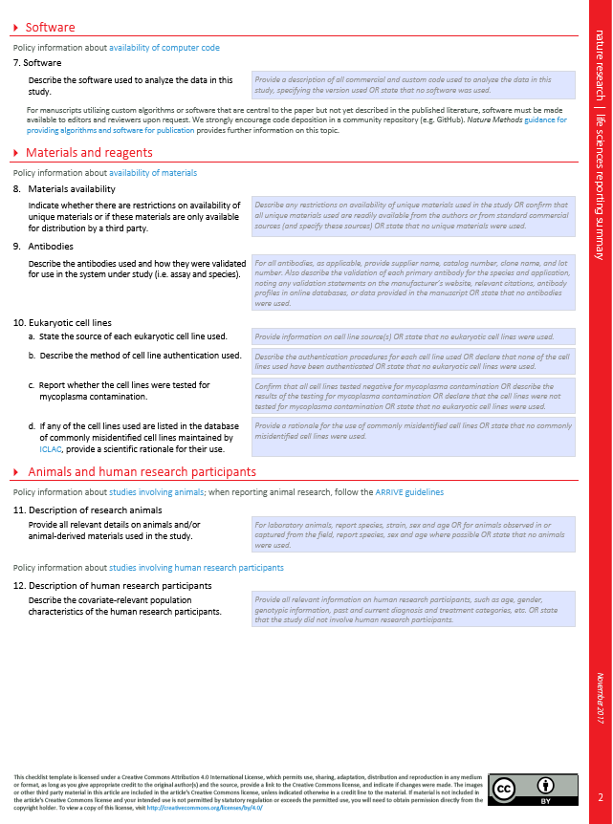
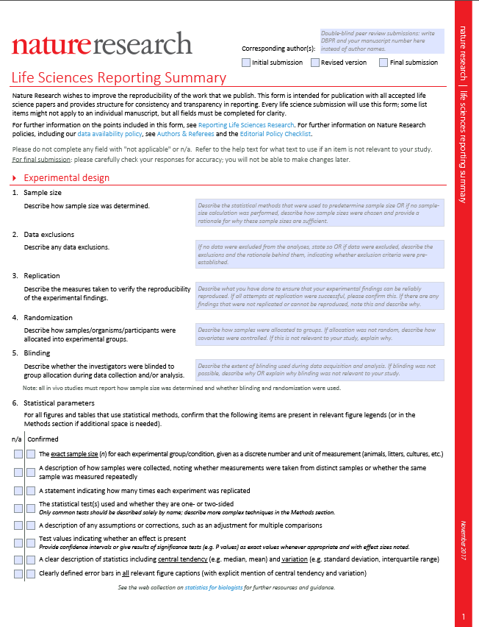
Life Sciences
Nature reproducibility initiative.
“Announcement: Reducing our irreproducibility,” Nature News, vol. 496, no. 7446, p. 398, Apr. 2013.

Slide 11
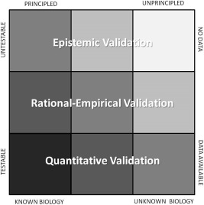
Biomedical Research
Rigorous Science: a How-To Guide
A Framework to Establish Model Credibility
A Pentateuch for improving rigor in the biomedical sciences:
Redundancy in experimental design
Sound statistical analysis
Recognition of error
Avoidance of logical traps
Intellectual honesty
A. Casadevall and F. C. Fang, “Rigorous Science: a How-To Guide,” mBio, vol. 7, no. 6, pp. e01902-16, Dec. 2016.
E. A. Patterson and M. P. Whelan, “A framework to establish credibility of computational models in biology,” Progress in Biophysics and Molecular Biology, vol. 129, pp. 13–19, Oct. 2017.

Slide 12
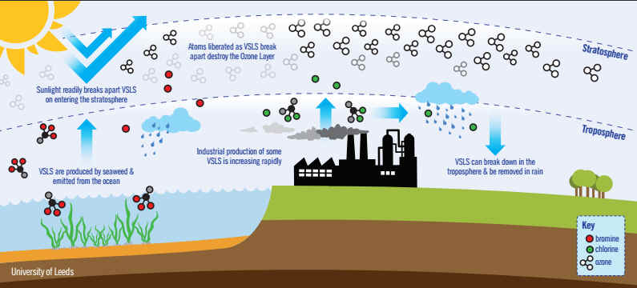
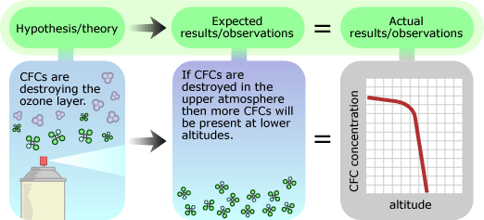
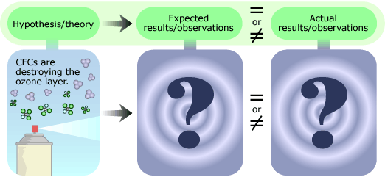
Atmospheric Modeling
Candace Gilet, “Ozone depletion: Uncovering the hidden hazard of hairspray.” University of California Museum of Paleontology. https://undsci.berkeley.edu/article/0_0_0/ozone_depletion_01
Understanding the effect of CFCs on ozone depletion
Too complex to understand work out by hand
Build a model to understand system
Test against a different prediction.
Predictions of ozone depletion are long-term. Don’t want to wait around to see what happens!

Slide 13
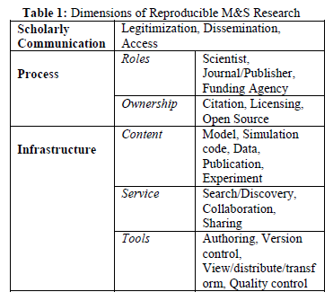
Modeling & Simulation in Social Science
Verification and Validation (V&V)
Reproducibility & Replication (R&R)
A. Tolk, S. Y. Diallo, J. J. Padilla, and R. Gore, “Epistemology of Modeling and Simulation: How can we gain Knowledge from Simulations?,” arXiv preprint arXiv:1306.5215, 2013.
R. G. Sargent, “Validation and verification of simulation models,” in Proceedings of the 36th conference on Winter simulation, 2004, pp. 17–28.
Simon JE Taylor, Azam Khan, Katherine L Morse, Andreas Tolk, Levent Yilmaz, and Justyna Zander, “Grand challenges on the theory of modeling and simulation,” in Proceedings of the Symposium on Theory of Modeling & Simulation-DEVS Integrative M&S Symposium, 2013.
A. Tolk et al., “Epistemology of modeling and simulation,” in Proceedings of the 2013 Winter Simulation Conference: Simulation: Making Decisions in a Complex World, 2013, pp. 1152–1166.

Slide 14
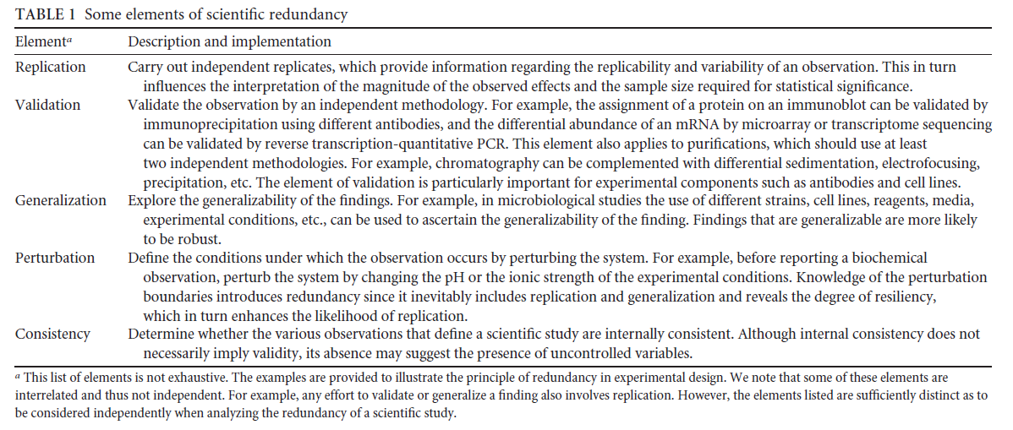
Reproducibility – the ability to reproduce or independently recreate computational artifacts associated with published works
Replicability – the ability to create a new implementation of a conceptual model that differs in some way (e.g. platform, modeling formalism, language) from the original model.
Some notes from other fields
Galileo Galilei, Dialogues concerning two new sciences. New York: Macmillan, 1638.
Tolk, Andreas, Brian L. Heath, Martin Ihrig, Jose J. Padilla, Ernest H. Page, E. Dante Suarez, Claudia Szabo, Paul Weirich, and Levent Yilmaz. “Epistemology of Modeling and Simulation.” In Proceedings of the 2013 Winter Simulation Conference: Simulation: Making Decisions in a Complex World, 1152–1166. IEEE Press, 2013.
A. Casadevall and F. C. Fang, “Rigorous Science: a How-To Guide,” mBio, vol. 7, no. 6, pp. e01902-16, Dec. 2016.

Slide 15
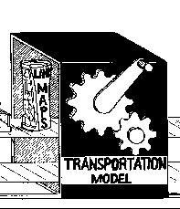
How does this apply to us?
Proposed principles of travel modeling as a science
1. We build models to predict change. We should evaluate them on their ability to do so.
3. To compare models, we need competing predictions.
Not just cross-sectional calibration!
Easy to reproduce, and easy to replicate.
2. Our models should make testable predictions of important outcomes.
4. To generalize our findings, they should apply for multiple points in time and space.
Combine present-day testing with long-term archival.
More than one city, and more than one year.
https://www4.uwm.edu/cuts/primer.htm

Slide 16
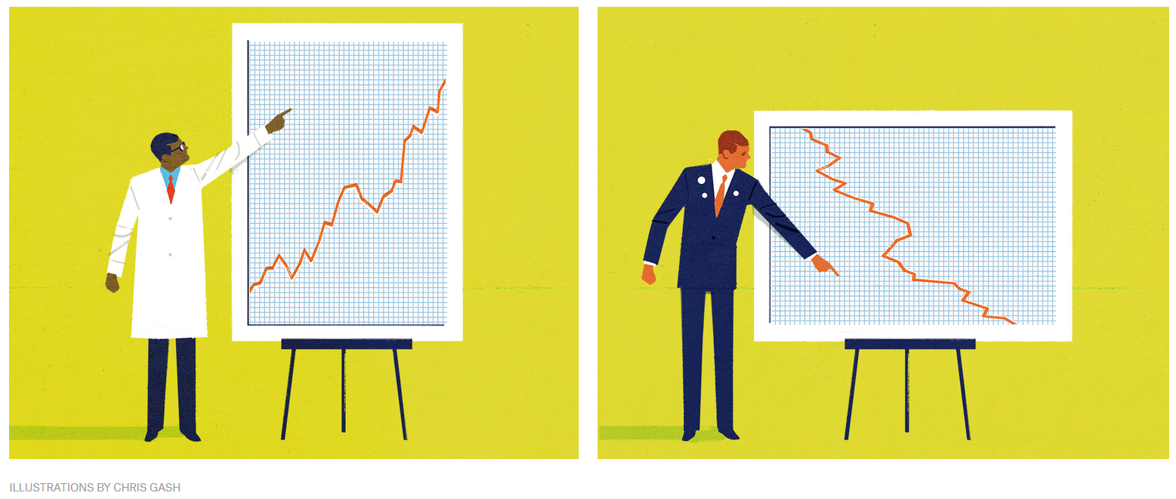
A word of caution…
“The easiest way to undermine good science is to demand that it be made “sound.””
We should hold ourselves to high standards, AND take credit for what we get right.
Aschwanden, Christie, “There’s No Such Thing As ‘Sound Science.’” FiveThirtyEight (blog), December 6, 2017. https://fivethirtyeight.com/features/the-easiest-way-to-dismiss-good-science-demand-sound-science/.

Slide 17
Intellectual Honesty
Intellectual honesty is an applied method of problem solving, characterized by an unbiased, honest attitude, which can be demonstrated in a number of different ways, including but not limited to: One's personal beliefs do not interfere with the pursuit of truth; Relevant facts and information are not purposefully omitted even when such things may contradict one's hypothesis; Facts are presented in an unbiased manner, and not twisted to give misleading impressions or to support one view over another; References, or earlier work, are acknowledged where possible, and plagiarism is avoided. Harvard ethicist Louis M. Guenin describes the "kernel" of intellectual honesty to be "a virtuous disposition to eschew deception when given an incentive for deception." Intentionally committed fallacies in debates and reasoning are sometimes called intellectual dishonesty.
http://www.definitions.net/definition/intellectual%20honesty

Slide 18
Intellectual Honesty
Did you make up your mind before or after reviewing the evidence?
Are you open to the possibility of being wrong?
Are you an advocate or an analyst?

Slide 19
Questions & Discussion
Greg Erhardt, University of Kentucky David Ory, Sidewalk Labs Kay Axhausen, ETHZ - Swiss Federal Institute of Technology Giovanni Circella, Georgia Institute of Technology (Georgia Tech) Song Gao, University of Massachusetts, Amherst Stephane Hess, University of Leeds Josephine Kressner, Transport Foundry Hani Mahmassani, Northwestern University Eric Miller, University of Toronto Rolf Moeckel, Technical University of Munich Alexei Pozdnoukhov, University of California, Berkeley Paul Waddell, University of California, Berkeley

Slide 20
Develop the epistemology of travel modeling
Putting these principles into action
# 1
Epistemology is the field of philosophy concerned with how we advance knowledge. Others have studied the epistemology of modeling and simulation.
Tolk, Andreas, Saikou Y. Diallo, Jose J. Padilla, and Ross Gore. “Epistemology of Modeling and Simulation: How Can We Gain Knowledge from Simulations?” ArXiv Preprint ArXiv:1306.5215, 2013.
“I have been, and remain, entirely committed to the idea that modeling is the essence of science and the habitat of all epistemology.
R. Rosen, Essays on Life Itself, 1500 edition. New York: Columbia University Press, 1999.
Articulate what we want to predict & generalize!

Slide 21
Some considerations
Why we model
Where we model
What we learn
How we use models
Modeling to forecast
Models built for one city
Specific project-level forecasts are difficult to generalize. For example, what is the typical ridership of a light rail line?
Learning about models
Estimated from data
Models are typically implemented for a single city or region.
Can we apply science to learn which models work best?
We estimate our models from data.
Modeling for insight
Data collected for one city
Learning about the world
Applied out-of-sample
We may also model to gain insight into behavior and relationships at the individual level or at the system level.
Data are often collected for a single city or region.
Can we apply models to learn about the real world?
But may apply them to situations that don’t exist yet—like self-driving cars.
Need to articulate what we want to generalize!
Need to articulate what we want to predict!

Slide 22
Putting these principles into action:
Year 1 Plan
Dave & Greg
Journal Editors
We are calling on the following actors to carry out the following actions in the next year. We promise to report back at the next TRB – at a minimum at the ADB 40 Committee meeting.
Survey journal editors to test the hypothesis that journals are less interested in publishing research reproducing previous results relative to novel findings
One journal will devote at least one special issue to reproducing or replicating previous, seminal findings on travel behavior.
Behavioral Researchers
Methods Researchers
Practitioners
Five articles published in leading journals will be published with data sets and scripts documented sufficiently to allow a PhD student to recreate the findings.
Two articles shall suggest a set of criteria that would either demonstrate that their methods are useful and should be explored further or are not useful and should no longer be explored. The criteria should be sufficient to be carried out by others.
Two MPOs, county, or states will publish the performance of their models across time (e.g., backcast across at least two historical years).

Slide 23
Validate our models across time and space
Putting these principles into action
# 1
Validating a model against base year data for a single year is not very convincing. Commit to testing models across time and space.

Slide 24
Value hypothesis testing as much as model development
Putting these principles into action
# 2
We often dismiss model application as “just pushing the buttons”. Change this culture and ask interesting questions of our models.

Slide 25
Create incentives for model reproducibility and replication
Putting these principles into action
# 3
Keep score of how easy it is to use someone else’s model.
Special issues or contests for reproducing or replicating published research.

Slide 26
Develop the epistemology of travel modeling
Putting these principles into action
# 4
How do we demark a “good model”?
What criteria do we use to reject a model?

Slide 27
How do travel models do?
Scientific Method
Travel Modeling Research
Collect and analyze travel data for my city.
Build a model with a shiny new widget based on a hypothesis of travel behavior.
Apply the model to predict the value of some field in my data set for which I already know the answer. (If I’m being really good, do this for a hold-back sample.)
Show that the goodness-of-fit measure is better than the old model.
Observation and description of natural phenomenon.
Formulation of a hypothesis to explain the phenomenon.
Use the hypothesis to predict other phenomenon or results.
Perform an experiment or experiments to ensure that results predicted based on hypothesis are achieved in the experiments.
Adapted from: Sant, Joseph (2017). The Scientific Method, Hypothesis, Prediction and Test. Retrieved from http://www.scientus.org/Science-Method.html on Apr 14, 2017.

